Slide 1
CS F372 Operating Systems
09 – Process Synchronization Solutions

Slide 2
Text Book Reading
Chapter 5
Sections 5.3, 5.4 (till compare and swap instruction) and 5.5

Slide 3
Peterson’s Solution
Two process software solution
Processes are denoted as P0 and P1
The two processes share two variables:
int turn
Boolean flag[2]
The variable turn indicates whose turn it is to enter the critical section
The flag array is used to indicate if a process is ready to enter the critical section.
flag[i] = true implies that process P_{i} is ready!

Slide 4
Peterson’s solution to CS
Algorithm for Process P_{i}
do {
flag[i] = true;
turn = j;
while (flag[j] && turn = = j);
critical section
flag[i] = false;
remainder section
} while (true);

Slide 5
Mutual Exclusion definition
Mutual Exclusion. If process P_{i} is executing in its critical section, then no other processes can be executing in their critical sections.

Slide 6
Peterson’s solution - Mutual Exclusion
Scenario 1: When only one process (P0) tries to enter CS
P0 | flag[0] | turn | flag[1] | P1
 | false | 0 | false
Changes flag | true
Changes turn |  | 1
Enters CS
Comes out of CS
Changes flag | false

Slide 7
Peterson’s solution - Mutual Exclusion
Scenario 2:
When both the
process tries to
enter CS
Peterson’s solution guarantees Mutual exclusion.
It can be seen that when P0 is in the critical section P1 is not allowed to enter its critical section.

Slide 8
Progress definition
Progress. If no process is executing in its critical section and there exist some processes that wish to enter their critical section, then the selection of the processes that will enter the critical section next is decided by those processes that are not in their reminder section and the decision cannot be postponed indefinitely

Slide 9
Peterson’s solution - Progress
In Peterson’s solution no process waits indefinitely to enter CS.
Depends on who modifies the value of turn lastly the other process can enter its CS.
Assume P1 modifies turn lastly. This enables P0 to enter CS
P0 | flag[0] | turn | flag[1] | P1
 | FALSE | 0 | FALSE
Changes flag[0] | TRUE
CONTEXT SWITCH
 |  |  | TRUE | Changes flag [1]
Changes turn |  | 1
 |  | 0 |  | Changes turn
 |  |  |  | Cannot enter CS
Enters CS
Out of CS
Changes flag[0] | false
 |  |  |  | Enters CS

Slide 10
Peterson’s solution - Progress
Assume P0 modifies turn lastly. This enables P1 to enter CS
P0 | flag[0] | turn | flag[1] | P1
 | FALSE | 0 | FALSE
Changes flag[0] | TRUE
CONTEXT SWITCH
 |  |  | TRUE | Changes flag [1]
 |  | 0 |  | Changes turn
Changes turn |  | 1
Cannot enter CS
 |  |  |  | Enters CS
 |  |  |  | Out of CS
 |  |  | false | Changes flag[1]
Enters CS

Slide 11
Peterson’s solution – Bounded waiting
For the bounded waiting requirement, after a process has requested to enter its critical section, the amount of time the process waits should be limited

Slide 12
Peterson’s solution - Bounded waiting
P0 | flag[0] | turn | flag[1] | P1
 | FALSE | 0 | FALSE
Changes flag[0] | TRUE
 |  |  | TRUE | Changes flag [1]
 |  | 0 |  | Changes turn
Changes turn |  | 1
Cannot enter CS
 |  |  |  | Enters CS
 |  |  |  | Out of CS
 |  |  | false | Changes flag[1]
 |  |  | True | Changes flag[1]
 |  | 0 |  | Changes turn
In Peterson’s solution any process is not allowed to enter critical section twice after the other process had requested to enter
critical section.
Thus, bounded waiting requirement is satisfied.

Slide 13
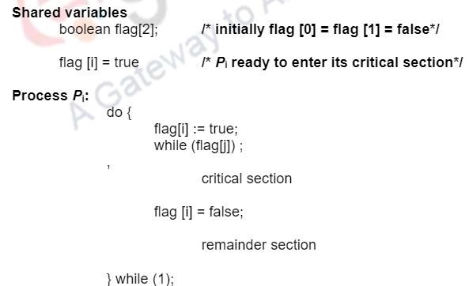
Example algorithm – No progress

Slide 14
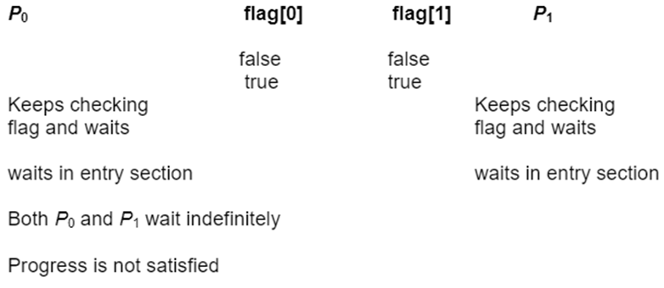
Example algorithm – No progress

Slide 15
Locks
It is a software tool to CSP
Used to protect a critical section and prevent race conditions
Process acquire lock before entering CS
It releases the lock when it exits the critical section
acquire() function acquires the lock
release() function releases the lock
Implementation:
Lock is implemented as a Boolean variable “available”
Value of “available” indicates if lock is available or not

Slide 16
acquire() { while (!available); /* busy wait */
available = false; }
If available = true /* No process is in its CS */
Then the lock is available
A call to acquire() succeeds
The lock is then made unavailable
If available = false /* Some process is in its CS */
Then the lock is unavailable
A process blocks/waits until the lock is released
This is called as busy wait and the lock is called as spin lock
Busy waiting wastes CPU cycles

Slide 17
release()
{
available = true;
}
Sets available to true

Slide 18
Solution to Critical-section Problem Using Locks
do {
acquire()
critical section
release()
remainder section
} while (TRUE);

Slide 19
Locks and race condition
acquire() { while (!available); /* busy wait */
available = false;
}
What if a Context Switch occurs when a process has tested the while and before making available as false.
Race condition!!!
Solution
Disable/enable interrupts
Calls to acquire() and release() must be atomic
Usually implemented via hardware mechanisms

Slide 20
Disable/enable interrupts
void acquire (lock) {
disable interrupts;
……………
}
void release (lock) {
…………….
enable interrupts;
}
Disabling interrupts blocks notification of external events that could trigger a context switch (e.g., timer)

Slide 21
Synchronization Hardware
Many systems provide hardware support for implementing the critical section code
Modern machines provide special atomic hardware instructions
Atomic = non-interruptible (prevents context switches)
Based on Locking – protects critical sections using locks
test and modify contents of a memory word
swap contents of two memory words

Slide 22
1. test_and_set Instruction
Definition:
boolean test_and_set (boolean *target)
{
boolean rv = *target;
*target = TRUE;
return rv:
}
Executed atomically
Takes a pointer (Boolean) as argument
Copies the value pointed by the pointer into another boolean variable rv
Set the new value of passed parameter to “TRUE”
Returns the original value of passed parameter

Slide 23
Mutual exclusion solution using test_and_set()
Shared Boolean variable lock, initialized to FALSE
Solution: Structure of process P_{i}
do { while (test_and_set(&lock));
/* do nothing */
/* critical section */
lock = false;
/* remainder section */
} while (true);

Slide 24
Mutual exclusion with test-and-set
P0 | LOCK | P1
 | FALSE
Test_and_set (lock) | TRUE
Enters CS
 | TRUE | Test_and_set (lock)
 |  | Cannot enter CS… waits
Out of CS | FALSE
 | TRUE | Test_and_set (lock)
 |  | Enters CS
Satisfies mutual exclusion

Slide 25
test_and_set – Bounded Waiting
Bounded waiting not satisfied
P0 | lock | P1
 | FALSE
Test_and_set (lock) | TRUE
Enters CS
 | TRUE | Test_and_set (lock)
 |  | Cannot enter CS
Out of CS | FALSE
Test_and_set (lock) | TRUE
Enters CS
 |  | Still waits

Slide 26
2. compare_and_swap Instruction
Definition:
int compare_and_swap(int *value, int expected, int new_value)
{
int temp = *value;
if (*value == expected)
*value = new_value;
return temp;
}

Slide 27
2. compare_and_swap Instruction
Executed atomically
Three operands
Returns the original value of passed parameter “value”
if “value” ==“expected”
Set the variable “value” the value of the passed parameter “new_value”.
That is, the swap takes place only under this condition.

Slide 28
Mutual exclusion solution using compare_and_swap
Shared integer “lock” initialized to 0;
Solution:
do {
while(compare_and_swap(&lock, 0, 1)!= 0);
/* do nothing */
/* critical section */
lock = 0;
/* remainder section */
} while (true);

Slide 29
Mutual Exclusion with compare_and_swap
Satisfies mutual exclusion
P0 | LOCK | P1
 | 0
Compare_and_swap (&lock,0,1) | 1
Enters CS
 | 1 | Compare_and_swap (&lock,0,1)
 |  | Cannot enter CS
Out of CS | 0
 | 1 | Compare_and_swap (&lock,0,1)
 |  | Enters CS

Slide 30
Bounded waiting with compare_and_swap
P0 | LOCK | P1
 | 0
Compare_and_swap (&lock,0,1) | 1
Enters CS
 | 1 | Compare_and_swap (&lock,0,1)
 |  | Cannot enter CS
Out of CS | 0
Compare_and_swap (&lock,0,1) | 1
Enters CS
 |  | Still waits
Bounded waiting not satisfied

